Slide 1
Google maps
朱荣飞

Slide 2
Getting the Google Maps Android API v2
Google Play services SDK
The Google Maps API Key
Retrieve information about your application's certificate.
Register a project in the Google APIs Console and add the Maps API as a service for the project.

Slide 3
Once you have a project set up, you can request one or more keys.
Finally, you can add your key to your application and begin development.

Slide 4
Debug certificate
The Maps API key is based on a short form of your application's digital certificate, known as its SHA-1 fingerprint
debug.keystore
OS X and Linux: ~/.android/
Windows Vista and Windows 7: C:\Users\your_user_name\.android\

Slide 5
List the SHA-1 fingerprint
keytool -list -v -keystore ~/.android/debug.keystore -alias androiddebugkey -storepass android -keypass android
Creating an API Project
Obtaining an API Key

Slide 6

API Access
Create New Android Key
BB:0D:AC:74:D3:21:E1:43:67:71:9B:62:91:AF:A1:66:6E:44:5D:75;com.example.android.mapexample
Adding the API Key to your application

Slide 7
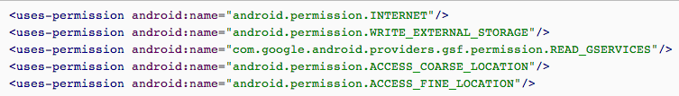

Specifying permissions
Requiring OpenGL ES version 2

Slide 8
GoogleMap
Connecting to the Google Maps service.
Downloading map tiles.
Displaying tiles on the device screen.
Displaying various controls such as pan and zoom.

Slide 9
Responding to pan and zoom gestures by moving the map and zooming in or out.
MapFragment
allows you to place a map in an Android Fragment
act as containers for the map, and provide access to the GoogleMap object

Slide 10
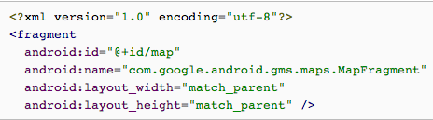
Add a Map to an Android application
get the API, obtain a key and add the required attributes to your Android Manifes
Add a Fragment object to the Activity

Slide 11

In the Activity object's onCreate() method, get a handle to the GoogleMap object in the MapFragment
add permissions and other settings to your application's manifest

Slide 12
Verify Map availability
MapFragment.getMap()
Map Types
Normal, Hybrid, Satellite, Terrain, None
Change the Map Type

Slide 13

Configuring Initial State
Using XML Attributes
Programmatically

Slide 14
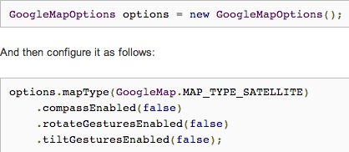
MapFragment.newInstance(GoogleMapOptions options)

Slide 15
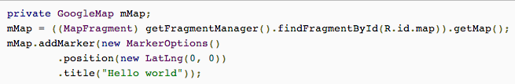
Add a marker
Position (Required), Title, Snippet, Draggable, Visible, Anchor, Icon

Slide 16
Info windows
GoogleMap.setInfoWindowAdapter()
getInfoWindow(Marker) ,getInfoContents(Marker)

Slide 17
Marker click events
GoogleMap.setOnMarkerClickListener(OnMarkerClickListener)
onMarkerClick(Marker)

Slide 18
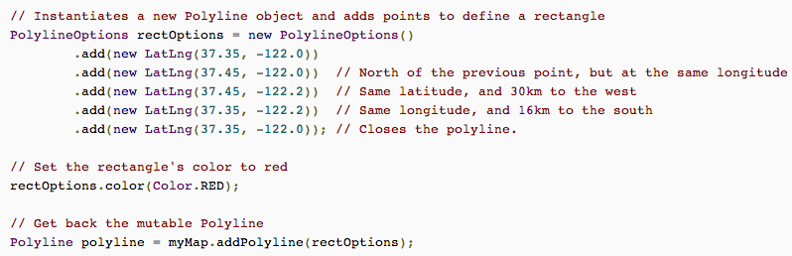
Polylines

Slide 19
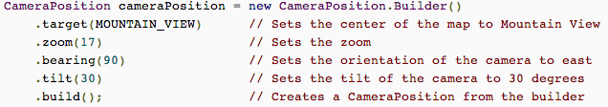
Changing a Map's View
target (latitude/longitude location), zoom, bearing and tilt.

Slide 20
Changing zoom level, Changing camera position, Setting boundaries, Panning
Create different types of CameraUpdate using CameraUpdateFactory
Updating the Camera View
GoogleMap.moveCamera ,GoogleMap.animateCamera

Slide 21
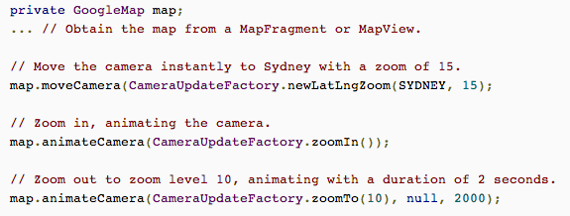

Slide 22
谢谢！

